Slide 1
Digital to Analog Conversion (DAC)

Slide 2
Outline
Purpose
Types
Performance Characteristics
Applications

Slide 3
Purpose
To convert digital values to analog voltages
Performs inverse operation of the Analog-to-Digital Converter (ADC)
Reference Voltage
DAC
Digital Value
Analog Voltage

Slide 4
DACs
Types
Binary Weighted Resistor
R-2R Ladder
Multiplier DAC
The reference voltage is constant and is set by the manufacturer.
Non-Multiplier DAC
The reference voltage can be changed during operation.
Characteristics
Comprised of switches, op-amps, and resistors
Provides resistance inversely proportion to significance of bit

Slide 5
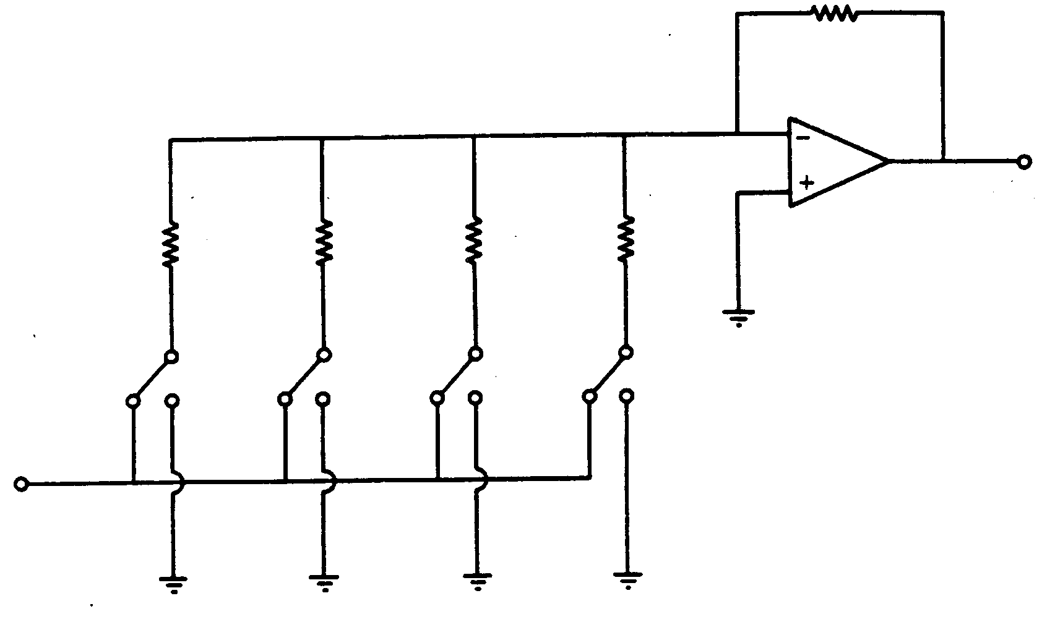
Binary Weighted Resistor
R_{f} = R
R
2R
4R
8R
V_{o}
MSB
LSB
-V_{REF}

Slide 6
Binary Representation
R_{f} = R
R
2R
4R
8R
V_{o}
Most
Significant Bit
Least
Significant Bit
-V_{REF}

Slide 7
Binary Representation
SET
CLEARED
Most
Significant Bit
Least
Significant Bit
-V_{REF}
( 1 1 1 1 )₂ = ( 15 )₁₀

Slide 8
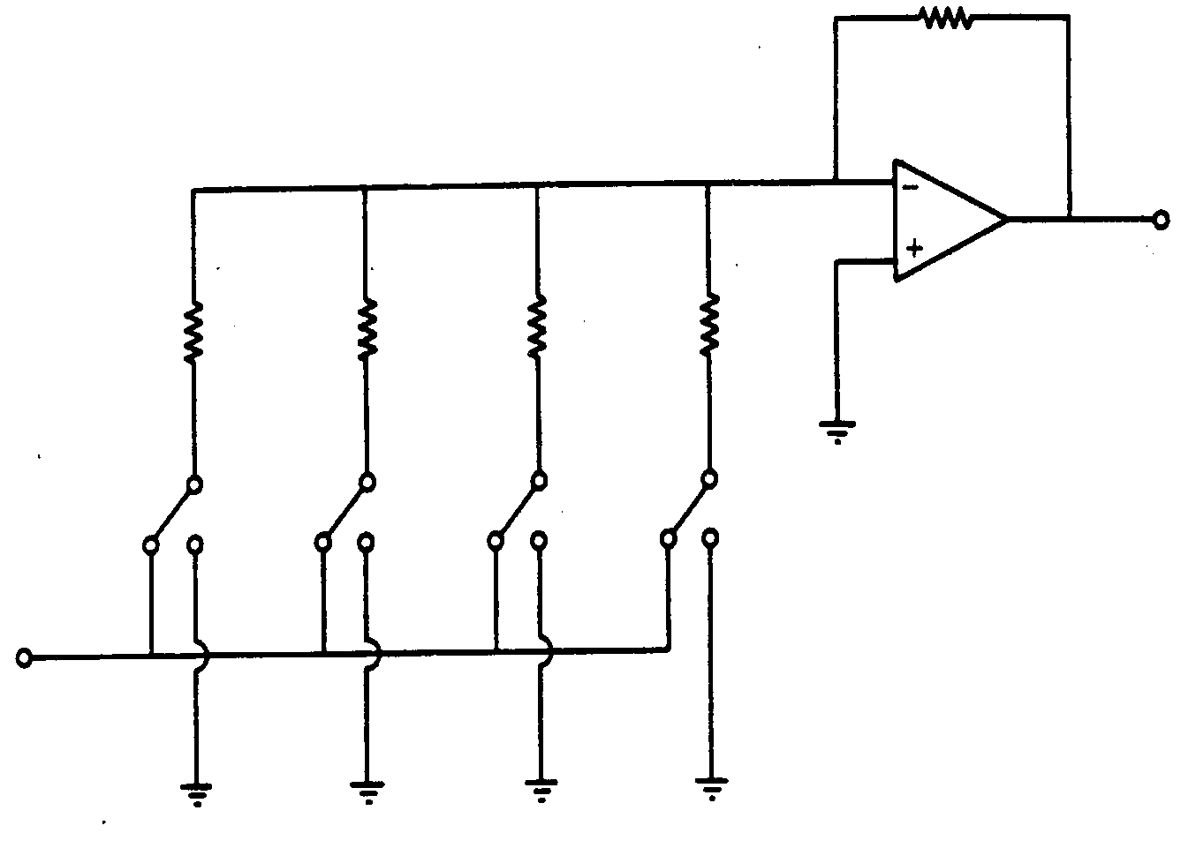
Binary Weighted Resistor
“Weighted Resistors” based on bit
Reduces current by a factor of 2 for each bit
R_{f} = R
R
2R
4R
8R
V_{o}
MSB
LSB
-V_{REF}

Slide 9
Binary Weighted Resistor
Result:

Slide 10
Binary Weighted Resistor
More Generally:
B_{i} = Value of Bit i
n = Number of Bits

Slide 11
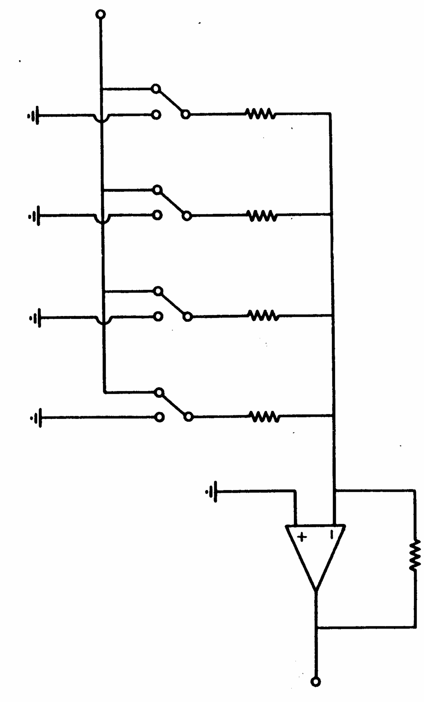
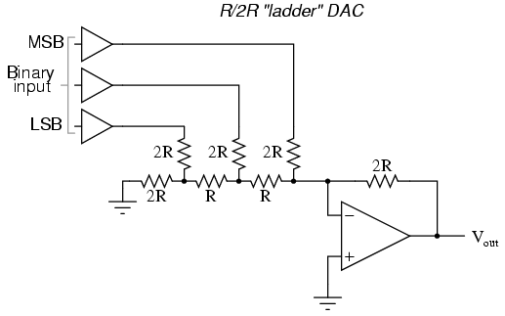

R-2R Ladder
V_{REF}
MSB
LSB

Slide 12
R-2R Ladder
Same input switch setup as Binary Weighted Resistor DAC
All bits pass through resistance of 2R
V_{REF}
MSB
LSB

Slide 13
R-2R Ladder
The less significant the bit, the more resistors the signal muss pass through before reaching the op-amp
The current is divided by a factor of 2 at each node
LSB
MSB

Slide 14
R-2R Ladder
The current is divided by a factor of 2 at each node
Analysis for current from (001)₂ shown below
R
R
R
2R
R
2R
2R
2R
B₂
Op-Amp input
“Ground”
V_{REF}
B₁
B₀

Slide 15

R-2R Ladder
Result:
B_{i} = Value of Bit i
R_{f}

Slide 16
R-2R Ladder
If R_{f} = 6R, V_{OUT} is same as Binary Weighted:
B_{i} = Value of Bit i

Slide 17
R-2R Ladder
Example:
Input = (101)₂
V_{REF} = 10 V
R = 2 Ω
R_{f} = 2R
R
R
R
2R
R
2R
2R
2R
V_{REF}
V_{REF}
Op-Amp input
“Ground”
B₀
B₂

Slide 18
Pros & Cons
 | Binary Weighted | R-2R
Pros | Easily understood | Only 2 resistor values Easier implementation Easier to manufacture Faster response time
Cons | Limited to ~ 8 bits Large # of resistors Susceptible to noise Expensive Greater Error | More confusing analysis

Slide 19
Digital to Analog Converters
Performance Specifications
Common Applications
Presented by: Mark Hunkele

Slide 20
Digital to Analog Converters -Performance Specifications
Resolution
Reference Voltages
Settling Time
Linearity
Speed
Errors

Slide 21
Digital to Analog Converters -Performance Specifications -Resolution
Resolution: is the amount of variance in output voltage for every change of the LSB in the digital input.
How closely can we approximate the desired output signal(Higher Res. = finer detail=smaller Voltage divisions)
A common DAC has a 8 - 12 bit Resolution
N = Number of bits

Slide 22
Digital to Analog Converters -Performance Specifications -Resolution
Poor Resolution(1 bit)
Better Resolution(3 bit)
Vout
Vout
Desired Analog signal
Desired Analog signal
111
110
110
2 Volt. Levels
1
8 Volt. Levels
101
101
100
100
011
011
010
010
001
001
0
0
000
000
Digital Input
Approximate output
Digital Input
Approximate output

Slide 23
Digital to Analog Converters -Performance Specifications -Reference Voltage
Reference Voltage: A specified voltage used to determine how each digital input will be assigned to each voltage division.
Types:
Non-multiplier: internal, fixed, and defined by manufacturer
Multiplier: external, variable, user specified

Slide 24
Digital to Analog Converters -Performance Specifications -Reference Voltage
Non-Multiplier: (Vref = C)
Multiplier: (Vref = Asin(wt))
Voltage
Voltage
11
11
10
10
10
10
01
01
01
01
0
0
00
00
00
00
Digital Input
Digital Input
Assume 2 bit DAC

Slide 25
Digital to Analog Converters -Performance Specifications -Settling Time
Settling Time: The time required for the input signal voltage to settle to the expected output voltage(within +/- VLSB).
Any change in the input state will not be reflected in the output state immediately. There is a time lag, between the two events.

Slide 26
Digital to Analog Converters -Performance Specifications -Settling Time
Analog Output Voltage
+VLSB
Expected Voltage
-VLSB
Time
Settling time

Slide 27
Digital to Analog Converters -Performance Specifications -Linearity
Linearity: is the difference between the desired analog output and the actual output over the full range of expected values.
Ideally, a DAC should produce a linear relationship between a digital input and the analog output, this is not always the case.

Slide 28
Digital to Analog Converters -Performance Specifications -Linearity
Linearity(Ideal Case)
NON-Linearity(Real World)
Desired/Approximate Output
Desired Output
Analog Output Voltage
Analog Output Voltage
Approximate output
Digital Input
Digital Input
Perfect Agreement
Miss-alignment

Slide 29
Digital to Analog Converters -Performance Specifications -Speed
Speed: Rate of conversion of a single digital input to its analog equivalent
Conversion Rate
Depends on clock speed of input signal
Depends on settling time of converter

Slide 30
Digital to Analog Converters -Performance Specifications -Errors
Non-linearity
Differential
Integral
Gain
Offset
Non-monotonicity

Slide 31
Digital to Analog Converters -Performance Specifications -Errors: Differential Non-Linearity
Differential Non-Linearity: Difference in voltage step size from the previous DAC output (Ideally All DLN’s = 1 VLSB)
Ideal Output
Analog Output Voltage
Diff. Non-Linearity = 2VLSB
2VLSB
VLSB
Digital Input

Slide 32
Digital to Analog Converters -Performance Specifications -Errors: Integral Non-Linearity
Integral Non-Linearity: Deviation of the actual DAC output from the ideal (Ideally all INL’s = 0)
Ideal Output
Analog Output Voltage
Int. Non-Linearity = 1VLSB
1VLSB
Digital Input

Slide 33
Digital to Analog Converters -Performance Specifications -Errors: Gain
Gain Error: Difference in slope of the ideal curve and the actual DAC output
High Gain
High Gain Error: Actual slope greater than ideal
Desired/Ideal Output
Low Gain Error: Actual slope less than ideal
Analog Output Voltage
Low Gain
Digital Input

Slide 34
Digital to Analog Converters -Performance Specifications -Errors: Offset
Offset Error: A constant voltage difference between the ideal DAC output and the actual.
The voltage axis intercept of the DAC output curve is different than the ideal.
Output Voltage
Desired/Ideal Output
Positive Offset
Digital Input
Negative Offset

Slide 35
Digital to Analog Converters -Performance Specifications -Errors: Non-Monotonicity
Non-Monotonic: A decrease in output voltage with an increase in the digital input
Desired Output
Non-Monotonic
Analog Output Voltage
Monotonic
Digital Input

Slide 36
Digital to Analog Converters -Common Applications
Generic use
Circuit Components
Digital Audio
Function Generators/Oscilloscopes
Motor Controllers

Slide 37
Digital to Analog Converters -Common Applications -Generic
Used when a continuous analog signal is required.
Signal from DAC can be smoothed by a Low pass filter
Piece-wise Continuous Output
Analog Continuous Output
Digital Input
n bit DAC
0 bit
011010010101010100101
101010101011111100101
000010101010111110011
010101010101010101010
111010101011110011000
100101010101010001111
Filter
n^{th} bit

Slide 38
Digital to Analog Converters -Common Applications -Circuit Components
Voltage controlled Amplifier
digital input, External Reference Voltage as control
Digitally operated attenuator
External Reference Voltage as input, digital control
Programmable Filters
Digitally controlled cutoff frequencies

Slide 39
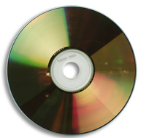
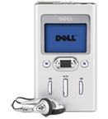
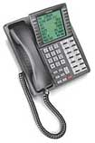
Digital to Analog Converters -Common Applications -Digital Audio
CD Players
MP3 Players
Digital Telephone/Answering Machines
1
2
3
1. http://electronics.howstuffworks.com/cd.htm
2. http://accessories.us.dell.com/sna/sna.aspx?c=us&cs=19&l=en&s=dhs&~topic=odg_dj
3. http://www.toshiba.com/taistsd/pages/prd_dtc_digphones.html

Slide 40
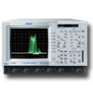
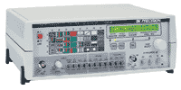
Digital to Analog Converters -Common Applications -Function Generators
Digital Oscilloscopes
Digital Input
Analog Ouput
Signal Generators
Sine wave generation
Square wave generation
Triangle wave generation
Random noise generation
1
2
1. http://www.electrorent.com/products/search/General_Purpose_Oscilloscopes.html
2. http://www.bkprecision.com/power_supplies_supply_generators.htm

Slide 41
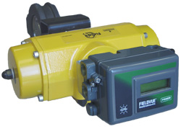
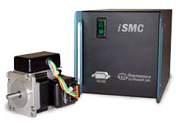
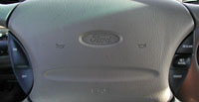
Digital to Analog Converters -Common Applications -Motor Controllers
Cruise Control
Valve Control
Motor Control
1
2
3
1. http://auto.howstuffworks.com/cruise-control.htm
2. http://www.emersonprocess.com/fisher/products/fieldvue/dvc/
3. http://www.thermionics.com/smc.htm

Slide 42
References
Cogdell, J.R. Foundations of Electrical Engineering. 2nd ed. Upper Saddle River, NJ: Prentice Hall, 1996.
“Simplified DAC/ADC Lecture Notes,” http://www-personal.engin.umd.umich.edu/ ~fmeral/ELECTRONICS II/ElectronicII.html
“Digital-Analog Conversion,” http://www.allaboutcircuits.com.
Barton, Kim, and Neel. “Digital to Analog Converters.” Lecture, March 21, 2001. http://www.me.gatech.edu/charles.ume/me4447Spring01/ClassNotes/dac.ppt.
Chacko, Deliou, Holst, “ME6465 DAC Lecture” Lecture, 10/ 23/2003, http://www.me.gatech.edu/mechatronics_course/
Lee, Jeelani, Beckwith, “Digital to Analog Converter” Lecture, Spring 2004, http://www.me.gatech.edu/mechatronics_course/

